Slide 1
Mining Association Rules in Large Databases

Slide 2
Association Analysis
Mining for associations among items in a large database of transactions is an important data mining function.
Association rule learning is a popular and well researched method for discovering interesting relations between variables in large databases.
Association rules are statements of the form {X1, X₂, …, Xn} => Y, meaning that if we find all of X₁, X₂, ……… , Xn in the transaction then we have good chance of finding Y.
Eg: The information that a customer who buys computer also tends to buy antivirus or pen drive.
Association analysis mostly applied in the field of market basket analysis, web-based mining, intruder detection etc.

Slide 3
Market Basket Analysis
Market basket analysis (also known as Affinity Analysis) is the study of items that are purchased or grouped together in a single transaction or multiple, sequential transactions.
Understanding the relationships and the strength of those relationships is valuable information that can be used to make recommendations, cross-sell, up-sell, offer coupons, etc.
A predictive market basket analysis can be used to identify sets of products/services purchased/events) that generally occur in sequence or something of interest to direct marketers.

Slide 4
Market Basket Analysis
Advanced Market Basket Analysis provides an excellent way to get to know the customer and understand the different behaviors that can be used to provide better design a better plan and devise more attractive promotions that can lead to more sales and profits.
The analysis can be applied in various ways:
Develop combo offers based on products sold together.
Organize and place associated products/categories nearby inside a store.
Determine the layout of the catalog of an ecommerce site.
Control inventory based on product demands and what products sell together.

Slide 5
Market Basket Analysis
In order to gain better insights, Market Basket Analysis can based on
Weekend vs weekday sales
Month beginning vs month-end sales
Different seasons of the year
Different stores
Different customer profiles

Slide 6
Market Basket Analysis
For a financial services company
Analysis of credit and debit card purchases.
Analysis of cheque payments made.
Analysis of services/products taken e.g. a customer who has taken executive credit card is also likely to take personal loan.
For a telecom operator
Analysis of telephone calling patterns.
Analysis of value-add services taken together.

Slide 7
Terminologies used in association analysis
Support: The support of an association pattern is the percentage of task-relevant data transaction for which the pattern is true.
Support (A): Number of tuples containing A / Total number of tuples
Support (A = > B): Number of tuples containing A and B / Total number of tuples
If minsup is set too high, we could miss itemsets involving interesting rare items (e.g., expensive products)
If minsup is set too low, it is computationally expensive and the number of itemsets is very large

Slide 8
Terminologies used in association analysis
Confidence: Confidence is defined as the measure of certainty or trustworthiness associated with each discovered pattern.
Confidence (A = > B): Number of tuples containing A and B / Total count of A
Itemset
A collection of one or more items. Example: {Milk, Bread, Diaper}
An itemset that contains k items is called k-itemset.

Slide 9
Terminologies used in association analysis
Frequent Itemset
An itemset whose support is greater than or equal to a minimum support threshold.
Maximal Frequent Itemset:
An itemset is maximal if none of its immediate supersets is frequent.
Closed Itemset:
An itemset is closed if none of its immediate supersets has same support as of the itmeset.

Slide 10
Terminologies used in association analysis
Lift
Lift is a measure of the performance of a targeting model (association rule) at predicting or classifying cases.
Lift can be found by dividing the confidence by the unconditional probability of the consequent, or by dividing the support by the probability of the antecedent times the probability of the consequent.
Lift = P(Y | X ) /P(Y )

Slide 11
Association Rules Mining
Given a set of transactions T, the goal of association rule mining is to find all rules having support ≥ minsup threshold and confidence ≥ minconf threshold.
Some of approaches for association rules mining are:
Brute- Force Approach
Apriori Approach
Frequent Pattern (FP) Growth Method

Slide 12
Brute- Force Approach
List all possible association rules.
Compute the support and confidence for each rule.
Prune rules that fail to minimum support and minimum confidence level.

Slide 13
Apriori Approach
Apriori approach is two step approach:
Frequent item generation and
Rules generation
Based on apriori principal

Slide 14
Apriori Principle:
Supersets of non-frequent item are also non-frequent. Or, If an itemset is frequent, then all of its subset also be frequent.
Apriori algorithm is an influential algorithm for mining frequent itemset.
It use a level-wise search, k-itemsets are used to explore k+1 itemsets.
At first, the set of frequent itemset is found and used to generate to frequent itemset at next level and so on.

Slide 15
Apriori Algorithm:
Read the transaction database and get support for each itemset, compare the support with minimum support to generate frequent itemset at level 1.
Use join to generate a set of candidate k-itmesets at next level.
Generate frequent itemsets at next level using minimum support.
Repeat step 2 and 3 until no frequent itme sets can be generated.
Generate rules form frequent itemsets from level 2 onwards using minimum confidence.

Slide 16
Reducing Number of Comparison
Candidate counting:
Scan the database of transactions to determine the support of each candidate itemset.
To reduce the number of comparisons, store the candidates in a hash structure
Instead of matching each transaction against every candidate, match it against candidates contained in the hashed buckets

Slide 17
Reducing Number of Comparison
Hash Table
A hash table (hash map) is a data structure used to implement an associative array, a structure that can map keys to values.
A hash table uses a hash function to compute an index into an array of buckets or slots, from which the correct value can be found.
Max leaf size: max number of itemsets stored in a leaf node, if number of candidate itemsets exceeds max leaf size, split the node.

Slide 18
Factors Affecting Complexity
Choice of minimum support threshold: Lowering support threshold results in more frequent itemsets.This may increase number of candidates and max length of frequent itemsets.
Dimensionality (number of items) of the data set: More space is needed to store support count of each item. If number of frequent items increases, both computation and I/O costs may also increase.

Slide 19
Factors Affecting Complexity
Size of database: Since Apriori makes multiple passes, run time of algorithm may increase with number of transactions.
Average transaction width: Transaction width increases with denser data sets. This may increase max length of frequent itemsets and traversals of hash tree (number of subsets in a transaction increases with its width)

Slide 20
Frequent Pattern (FP) Growth Method
Mining frequent itmesets without candidate generation.
It is a divide and conquers strategy.
It compress the database representing frequent items into a frequent –pattern tree (FP-Tree), which retains the itemset association information.
Divides the compressed database into a set of conditional databases, each associated with one frequent item or pattern fragment and then mines each such database separately.

Slide 21
Frequent Pattern (FP) Growth Method
FP-Growth method transforms the problem of finding long frequent patterns to searching for shorter ones recursively and then concatenating the suffix.
It uses least frequent items as suffix .
Adv: Reduce search cost, has good selectivity, faster than apriori.
Disadv: When the database is large, it is sometimes unrealistic to construct a main memory based FP-tree.

Slide 22
FP-Tree algorithm
Create root node of tree, labeled with null.
Scan the transactional database.
The items in each transaction are processed in sorted order (Descending) and branch is created for each transaction.

Slide 23
Categorical data
Categorical data is a statistical data type consisting of categorical variables, used for observed data whose value is one of a fixed number of nominal categories.
More specifically, categorical data may derive from either or both of observations made of qualitative data, where the observations are summarized as counts or cross tabulations, or of quantitative data.
Observations might be directly observed counts of events happening or they might counts of values that occur within given intervals.

Slide 24
Categorical data
Often, purely categorical data are summarized in the form of a contingency table.
However, particularly when considering data analysis, it is common to use the term "categorical data" to apply to data sets that, while containing some categorical variables, may also contain non-categorical variables.

Slide 25
Potential Issues
What if attribute has many possible values: Example: attribute country has more than 200 possible values. Many of the attribute values may have very low support.
Potential solution: Aggregate the low-support attributes values.
What if distribution of attribute values is highly skewed: Example: 95% of the visitors have Buy = No. Most of the items will be associated with (Buy=No) item
Potential solution: drop the highly frequent items

Slide 26
Handling Categorical Attributes
Transform categorical attribute into asymmetric binary variables. i.e If the outcomes of a binary variable are not equally important.
Introduce a new “item” for each distinct attribute- value pair.

Slide 27
Sequential Pattern
Mining of frequently occurring ordered events or subsequences as patterns. Eg: web sequence, book issued in library etc.
Used mostly in marketing, customer analysis, prediction modeling.
A sequence is an ordered list of events where an item can occur at most in an event of a sequence but can occur multiple times in different events of a sequence.
Given a set of sequences, where each sequence consists of a list of events or elements and each event consists of set of items, given a minimum support threshold, sequential pattern mining finds all frequent subsequences.

Slide 28
Sequential Pattern
Sequence with minimum support is called frequent sequence or sequential pattern.
A sequential pattern with length ‘l’ is called an l-pattern sequential pattern.
Sequential pattern is computationally challenging because such mining may generate combinationally explosive number of intermediate subsequences.
For efficient and scalable sequential pattern mining two common approaches are:
Mining the full set of sequential patterns
Mining only the set of closed sequential pattern

Slide 29
Sequential Pattern (Example)
Sequence_ID | Sequence
1 | {(a, (a,b,c), (a,c), (b,c)}
2 | {(a,b,c), (a,d),e,(d,e)}
3 | {( c,d), (a,d,e),e}
4 | { (e,f,),d,(a,b,c),f]

Slide 30
Sub-graph Patterns
It finds characteristics sub-graphs within the network.
It is a form of graph search.
Given a labeled graph data set, D = {G1, G2, …….,Gn}, a frequent graph has minimum support not less than minimum threshold support.
Frequent sub-graph pattern can be discovered by generating frequent substructures candidate and hence check the frequency of each candidate.

Slide 31
Sub-graph Patterns
Apriori methos and frequent –growth are tow common basic methods for finding frequent sub-graph
Extend association rule mining to finding frequent subgraphs
Useful for Web Mining, computational chemistry, bioinformatics, spatial data sets, etc
Eg::
Chemical Structure, Geographical Nodes

Slide 32
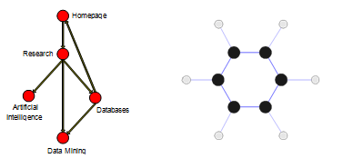
Sub-graph Patterns

Slide 33
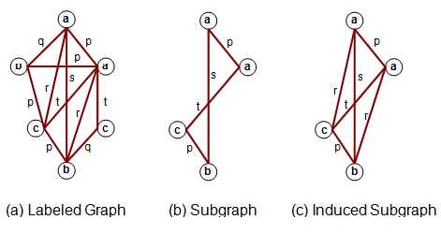
Sub-graph Patterns

Slide 34
Sub-graph Patterns
Challenges
Node may contain duplicate labels.
How to define support and confidence?
Additional constraints imposed by pattern structure
Support and confidence are not the only constraints
Assumption: frequent subgraphs must be connected
*Apriori-like approach:
Use frequent k-subgraphs to generate frequent (k+1) subgraphs

Slide 35
Frequent-Pattern Mining
Frequent-pattern mining finds a set of patterns that occur frequently in a data set, where a pattern can be a set of items (called an itemset), a subsequence, or a substructure.
A pattern is considered frequent if its count satisfies a minimum support. Scalable methods for mining frequent patterns have been extensively studied for static data sets.

Slide 36
Frequent-Pattern Mining
Challenges in mining data streams:
Many existing frequent-pattern mining algorithms require the system to scan the whole data set more than once, but this is unrealistic for infinite data streams.
A frequent itemset can become infrequent as well. The number of infrequent itemsets is exponential and so it is impossible to keep track of all of them.

Slide 37
Multilevel Association Rule :
Association rules created from mining information at different degrees of reflection are called various level or staggered association rules.
Multilevel association rules can be mined effectively utilizing idea progressions under a help certainty system.
Rules at a high idea level may add to good judgment while rules at a low idea level may not be valuable consistently.

Slide 38
Need of Multidimensional Rule :
Sometimes at the low data level, data does not show any significant pattern but there is useful information hiding behind it.
The aim is to find the hidden information in or between levels of abstraction.

Slide 39
Approaches to multilevel association rule mining:
Uniform Support(Using uniform minimum support for all level)
Reduced Support (Using reduced minimum support at lower levels)
Group-based Support(Using item or group based support)

Slide 40
Applications
Retail Sales Analysis
Healthcare Management
Fraud Detection
Web Usage Mining
Social Network Analysis

Slide 41
Challenges
High dimensionality
It is the problem of dealing with data sets that have a large number of attributes.
Large data set size
It is the problem of dealing with data sets that have a large number of records.
Scalability
It is the problem of dealing with data sets that are too large to fit into memory.

Slide 42
Correlation Analysis in Association Analysis:
Correlation Analysis is a data mining technique used to identify the degree to which two or more variables are related or associated with each other.
Correlation refers to the statistical relationship between two or more variables, where the variation in one variable is associated with the variation in another variable. In other words, it measures how changes in one variable are related to changes in another variable.
Correlation can be positive, negative, or zero, depending on the direction and strength of the relationship between the variables.

Slide 43
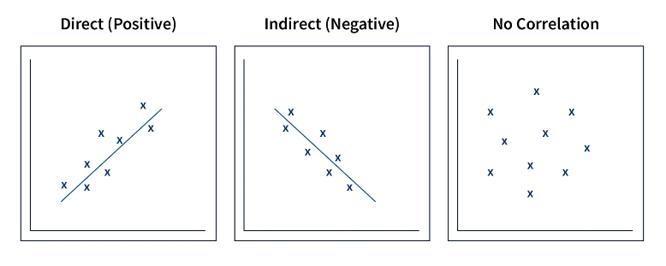
Correlation Analysis

Slide 44
Benefits of Correlation Analysis
Identifying Relationships
Prediction
Feature Selection
Quality Control

Slide 45
Constraint Based Mining
Constraint-based algorithms need constraints to decrease the search area in the frequent item set generation step.
The general constraint is based on the minimum support threshold.
Constraint-based clustering discover clusters that satisfy user-defined preferences or constraints. It depends on the characteristics of the constraints, constraint-based clustering can adopt rather than different approaches.

Slide 46
Constraint Types:
Knowledge type constraints
Data constraints
Interestingness constraints
Rule constraints

